Slide 1


Slide 2

Received strength

Slide 3

God’s promises cannot be manipulated or faked,
nor, can they fail.
When God makes a promise, He will provide the means for that promise to become reality!

Slide 4

BY FAITH
  POSER
  God’s promise: to make Abraham a great nation.
  Man’s problem: the failure of self-effort to fulfill God’s promises to them.

Slide 5
BY FAITH
  SARAH’S UNBELIEF
    When she lost hope, she reacted in desperation.
    She blamed God for her barren womb.
    She began to “strategize” instead of following in faith.

Slide 6
Unbelief often disguises itself
as a “smart idea”
You can always find someone
who agrees with your idea!

Slide 7
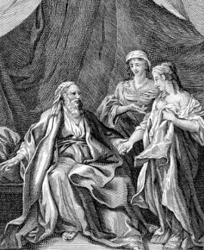
BY FAITH
  SARAH’S UNBELIEF
  Her faithlessness resulted in a bitter life!

Slide 8
your best, your plans, your manipulation can never bring
the joy and satisfaction of
simply trusting in the promises
of God for your life.

Slide 9
Heb 12:15 Looking diligently lest any man fail of the grace of God; lest any root of bitterness springing up trouble you, and thereby many be defiled;

Slide 10
BY FAITH
  SARAH’S UNBELIEF
  Her faithlessness resulted in a bitter life!
  On top of everything else, Sara’s biological clock has ran out.

Slide 11
BY FAITH
  POWER
  The Lord’s visitation encouraged her faith in God’s promise.
  Faith doesn’t run by our clock – it isn’t subject to our timing.
  Through faith, you receive the strength to see God’s promise become reality.

Slide 12
1 Cor 10:13 There hath no temptation taken you but such as is common to man: but God is faithful, who will not suffer you to be tempted above that ye are able; but will with the temptation also make a way to escape, that ye may be able to bear it.

Slide 13
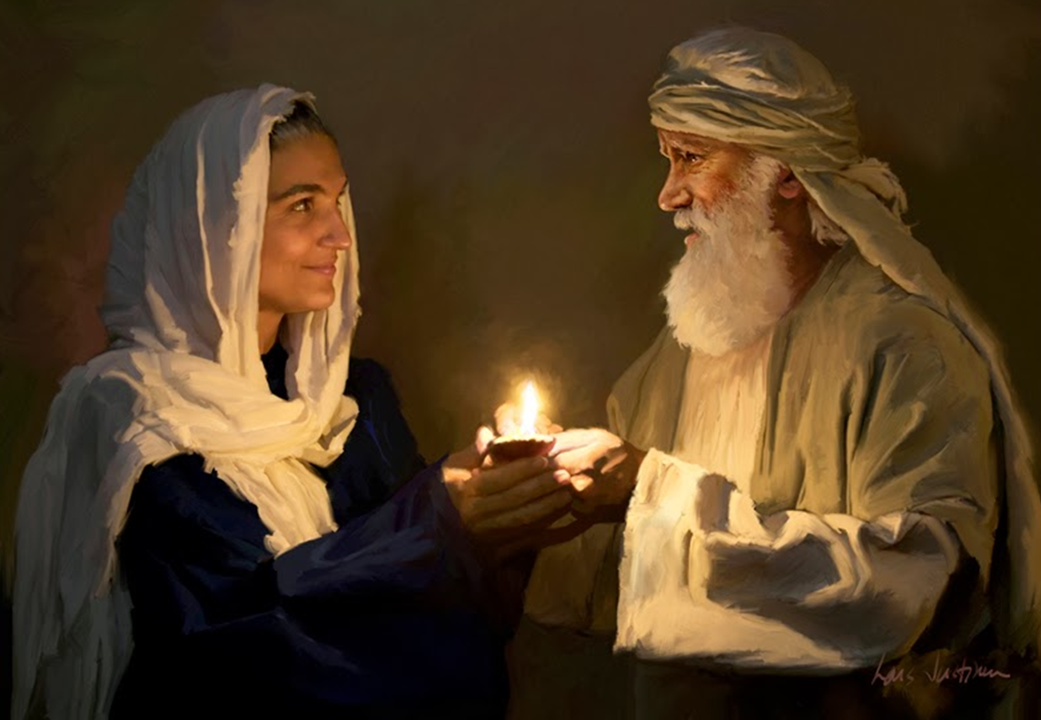

BY FAITH
  Sarah believed God and
  He strengthened her!

Slide 14
What God has promised
He will empower you to
fulfill if you will believe.

Slide 15
2 Tim 1:6-8 Wherefore I put thee in remembrance that thou stir up the gift of God, which is in thee by the putting on of my hands.
7 For God hath not given us the spirit of fear; but of power, and of love, and of a sound mind.
8 Be not thou therefore ashamed of the testimony of our Lord, nor of me his prisoner: but be thou partaker of the afflictions of the gospel according to the power of God;

Slide 16
Received strength

